Slide 1
Diabetes Readmission Prediction
Team Evolution
Manish (151340)
Nitish Sharma(151344)

Slide 2
Agenda
Abstract
Introduction
Data Description
Problem Statement
Methodology

Slide 3
Abstract
Background : Alarmingly high risk of readmission in the US
Goal : Discover factors contributing to hospitals readmissions
Methods : Supervised and Unsupervised Machine Learning Algorithm

Slide 4
Introduction
Topic : Diabetes Readmission Prediction
What is Readmission Rate
A hospitalization that occurs within 30 days after a discharge
Why is Readmission Important
Reduce cost of care and medical disputes
Improve Patient’s safety and health

Slide 5
Data Description
Data source: The data is from the Center for Clinical and Translational Research, Virginia Commonwealth University.
The dataset represents 10 years (1999-2008) of clinical care at 130 US hospitals and integrated delivery networks.
It includes 101,766 instances and 50 features representing patient and hospital outcomes.
Link : https://archive.ics.uci.edu/ml/datasets/Diabetes+130-US+hospitals+for+years+1999-2008
Notes:
The data contains such attributes as patient number, race, gender, age, admission type, time in hospital, medical specialty of admitting physician, number of lab test performed, HbA1c test result, diagnosis, number of medication, diabetic medications, number of outpatient, inpatient, and emergency visits in the year before the hospitalization, etc.

Slide 6
Problem Statement
Identify the major factors that contribute to hospital readmissions
Measure the influence of every attribute w.r.t Patient
Compare accuracy of each model

Slide 7
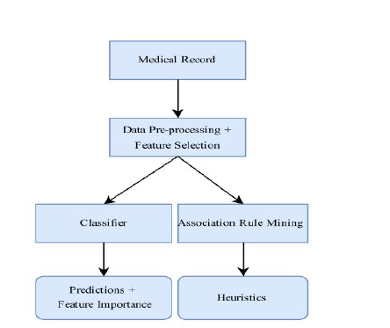
Methodology

Slide 8
Mining and Pre-Processing
Re-categorize Readmission feature from 3 groups to 2 groups (Readmission <30 days and Non-within 30 days)
Review all variables distribution to ensure data quality
Make Readmission group’s sample ratio be 1:1
Review each variable’s relationship with Readmission
Review numeric variables’ correlation

Slide 9
Recategorize Readmission Feature

Slide 10
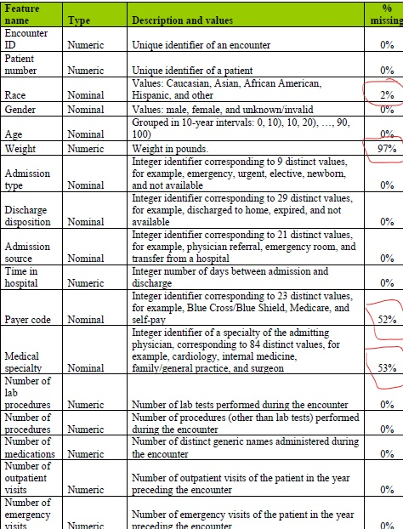
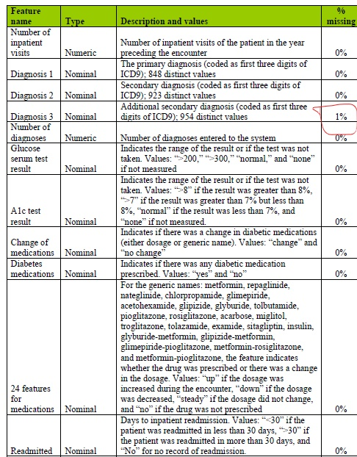
Missing Values

Slide 11
Dealing with Missing Values
Race – 2.23%
Weight – 96.86%
Payer-code – 39.56%
Medical-specialty – 49.08%
Diag1 – 0.02%
Diag2 – 0.35%
Diag3 – 1.40%
Drop features like ‘Weight', ‘Payer-code’ and ‘Medical-specialty' because it's hard to do imputation on them
Other features like ‘Race’ and ‘Diagnosis’ just remove null rows from data

Slide 12
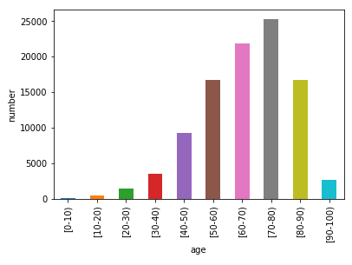
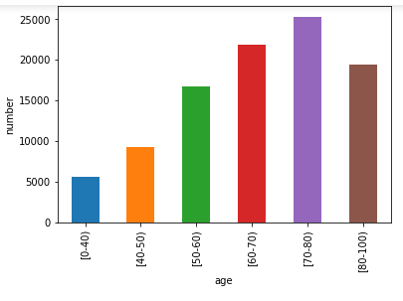
Balancing Age Group

Slide 13
Clean Features with Unbalanced Distribution
23 medicines features ['metformin', 'repaglinide', 'nateglinide', 'chlorpropamide’, …… , ‘insulin’]
Except ‘Insulin’, all other medicines have unbalanced distribution
Drop all other 22 features because they are irrelevant to patient

Slide 14
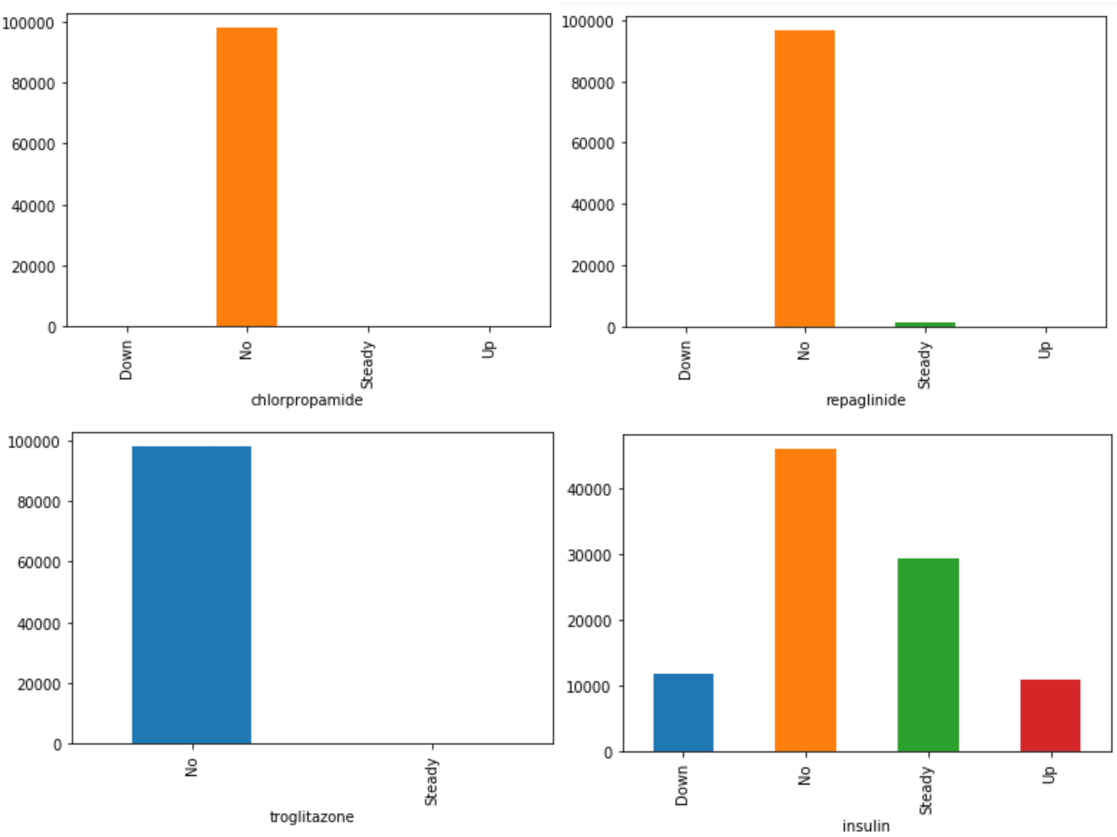
Unbalanced Features Distribution

Slide 15
Thank You

Slide 16
Questions?

